Slide 1
EMS702UP Statistical Thinking and Applied Machine Learning
W2.1 Descriptive Statistics
Jun Chen

Slide 2
Descriptive Statistics
Descriptive statistics are brief informational coefficients that summarise a given data set, which is often a sample of a population.
If a representation of the entire population is available (not very often), techniques similar to descriptive statistics can also be used to summarise the quantities of the population.
Descriptive Statistics concentrate on the basic tabular and diagrammatic techniques for displaying data and the calculation of elementary statistics.
A statistic is a numerical summary of a sample of data.
Descriptive statistics consist of three basic categories of measures: measures of frequency distribution, measures of central tendency (or location), and measures of variability (or spread).

Slide 3
Descriptive Statistics
Descriptive statistics consist of three basic categories of measures:
measures of frequency distribution, describe the occurrence of data within the data set (count)
measures of central tendency (or location), describe the centre of the data set (mean, median, mode)
measures of variability (or spread) describe the dispersion of the data set (variance, standard deviation).
These descriptive methods are used
as an important first step before we go on to apply more formal analyses,
to report results of learning algorithms, both numerically and graphically.

Slide 4
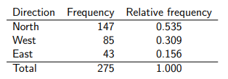
Descriptive Statistics – Frequency Tables
Frequency: The number of times of a certain value, in the case of categorical or discrete variables, or class defined over a class interval, in the case of continuous variable, is observed in the sample.
Total Frequency: The total frequency is the total number of observations.
Relative Frequency: The relative frequency is the proportion of the observations which fall in a particular category, value, or class. It is the frequency divided by the total frequency.
Example 1
Suppose that we observe vehicles at a crossroads for thirty minutes. Consider just the vehicles arriving at the junction from the South. Such vehicles can carry straight on to go North, turn left to go West or turn right to go East. Suppose that we see 147 of these vehicles go North, 85 go West and 43 go East.
Solution

Slide 5
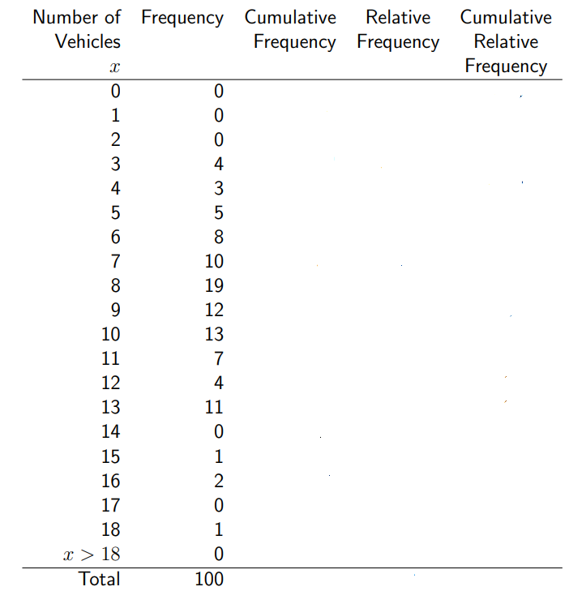
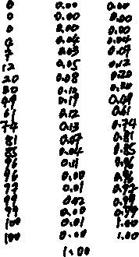
Descriptive Statistics – Frequency Tables
Example 2
The numbers of vehicles passing a point on a road in each of 100 intervals of length one minute are recorded in the frequency table below. Calculate the cumulative frequency, relative frequency and cumulative relative frequency and fill them out in the table below.
Solution

Slide 6
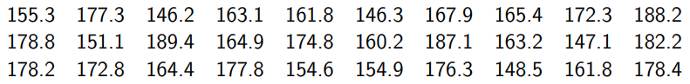
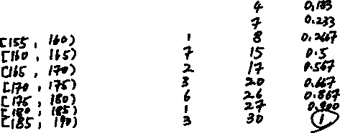
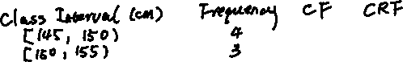
Descriptive Statistics – Frequency Tables
Example 3
The following data are the heights of a second sample of 30 students studying engineering statistics. Organise the data into classes using class intervals [145, 150), [150, 155), . . . , [185, 190) and construct a frequency table of the data.
Solution

Slide 7
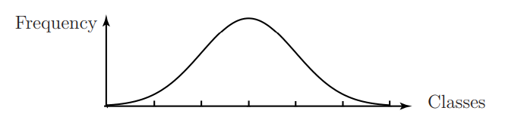

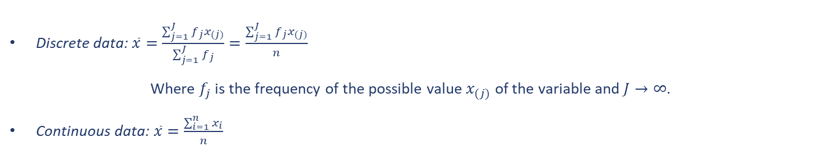
Descriptive Statistics – Measures of Location
The statistical properties of the observations in a sample are often described as a frequency distribution
There are three widely used measures of location – mean, median and mode .
Mean: the arithmetic average of the data.
Discrete data: $\overline{x}=\frac{\sum_{j=1}^{J}{{f_{j}x}_{(j)}}}{\sum_{j=1}^{J}{f_{j}}}=\frac{\sum_{j=1}^{J}{{f_{j}x}_{(j)}}}{n}$
Where $f_{j}$ is the frequency of the possible value $x_{(j)}$ of the variable and $J→∞$.
Continuous data:$\overline{x}=\frac{\sum_{i=1}^{n}{x_{i}}}{n}$
$In both cases, n$ is the size of the sample.

Slide 8
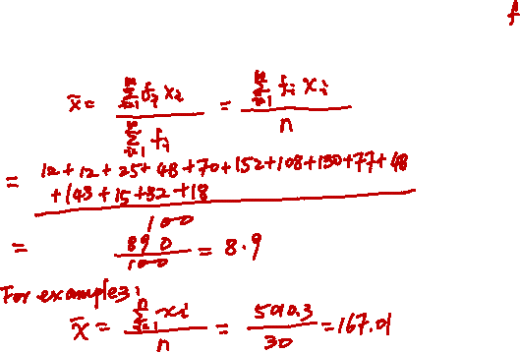
Descriptive Statistics – Measures of Location
Example 4
Calculate the sample means using the samples from Examples 2 and 3.
Solution

Slide 9
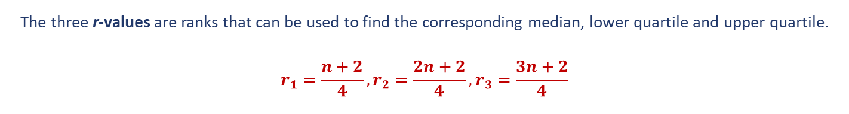

Descriptive Statistics – Measures of Location
Order Statistics: some statistics are derived from quantitative data which are placed in rank order (i.e. from the smallest to the largest). Median, Lower Quartile and Upper Quartile are order statistics which are used as measures of location.
The Median divides a sample of data into two equally sized groups, one containing the smaller observations and the other containing the larger observations.
The Lower Quartile divides the observations into a lower 25% and an upper 75%.
The Upper Quartile divides the observations into a lower 75% and an upper 25%.
The three r-values are ranks that can be used to find the corresponding median, lower quartile and upper quartile.
$$r_{1}=\frac{n+2}{4},r_{2}=\frac{2n+2}{4},r_{3}=\frac{3n+2}{4}$$

Slide 10
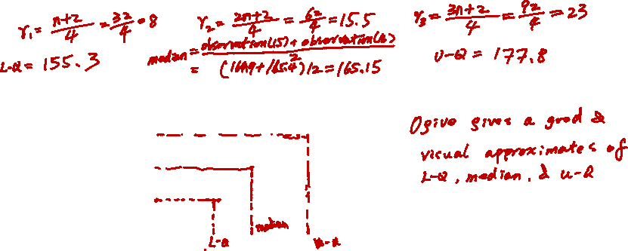
Descriptive Statistics – Measures of Location
Example 5
Calculate the median, lower quartile and upper quartile of the sample from Example 3.
Solution
In the case of larger samples, the quantities can be approximated by using a cumulative frequency curve or ogive.

Slide 11
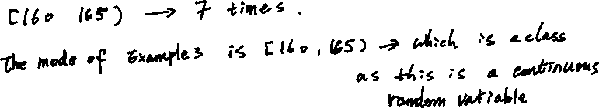
Descriptive Statistics – Measures of Location
Mode: the most frequently occurring value, in the case of discrete data, or class, in the case of continuous data, in the data set.
Example 6
Calculate the mode of the sample from Example 3.
Solution
If a frequency distribution is symmetric and unimodal, the mean, median and mode will be very similar. If a frequency distribution is not symmetric (i.e. the distribution is skewed as will be discussed in Section 3.3), then these three values can be quite different. In the latter case, the mean is not a resistant statistic comparing to the median.

Slide 12
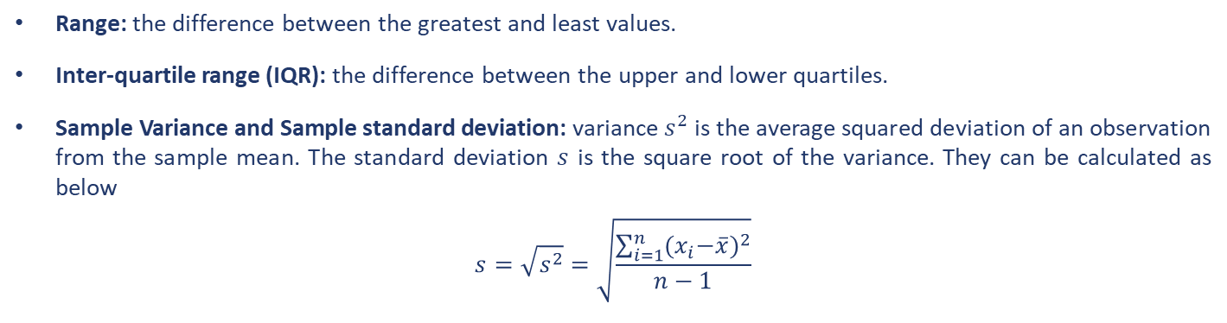
Descriptive Statistics – Measures of Spread
There are three widely used ways to measure the spread of a distribution about a central value (e.g. mean or median).
Range: the difference between the greatest and least values.
Inter-quartile range (IQR): the difference between the upper and lower quartiles.
Sample Variance and Sample standard deviation: variance $s^{2}$ is the average squared deviation of an observation from the sample mean. The standard deviation $s$ is the square root of the variance. They can be calculated as below
$$s=\sqrt{s^{2}}=\sqrt{\frac{\sum_{i=1}^{n}{{{(x}_{i}−\overline{x})}^{2}}}{n−1}}$$

Slide 13
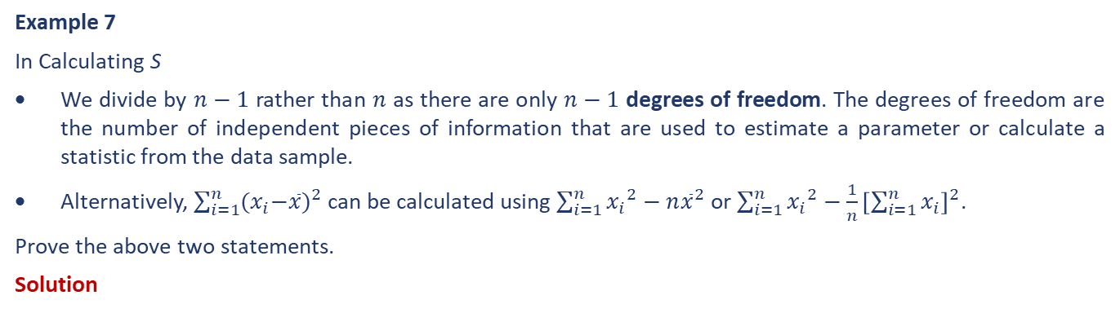
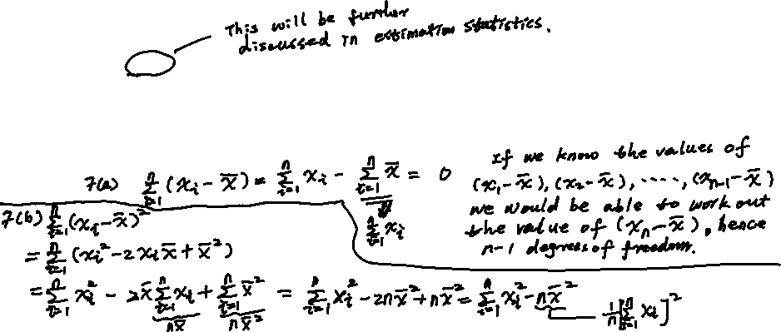
Descriptive Statistics – Measures of Spread
Example 7
In Calculating S
We divide by $n−1$ rather than $n$ as there are only $n−1$ degrees of freedom. The degrees of freedom are the number of independent pieces of information that are used to estimate a parameter or calculate a statistic from the data sample.
Alternatively, $\sum_{i=1}^{n}{{{(x}_{i}−\overline{x})}^{2}}$ can be calculated using $\sum_{i=1}^{n}{{{x_{i}}^{2}−n\overline{x}}^{2}}$ or $\sum_{i=1}^{n}{{x_{i}}^{2}}−\frac{1}{n}{\left[\sum_{i=1}^{n}{x_{i}}\right]}^{2}$.
Prove the above two statements.
Solution

Slide 14
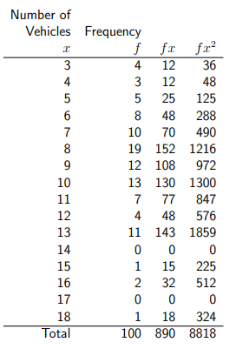
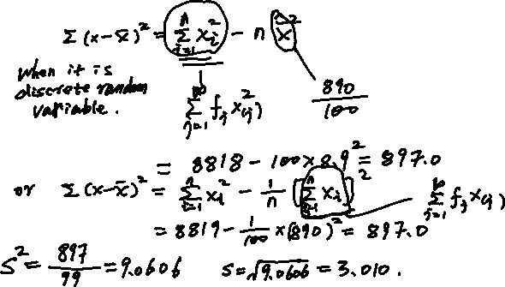
Descriptive Statistics – Measures of Spread
Example 8
Calculate the sample variance and sample standard deviation of the sample from Example 2.
Solution

Slide 15
Descriptive Statistics – Measures of Spread
If a frequency distribution is symmetric and unimodal, the sample variance and sample standard deviation are useful to provide a concise summary of the spread of the observed frequency distribution.
If a frequency distribution is not symmetric (i.e. the distribution is skewed as will be discussed in Section 3.3), then a more resistant statistic to describe the spread is IQR.

Slide 16
End slide

